Slide 1
AGENDA
https://goo.gl/forms/RT6Ec4upSRJzmqw53
PART 1: 3 Questions
Complete these questions upon arrival if you have not already.
Go here.
https://goo.gl/forms/RT6Ec4upSRJzmqw53

Slide 2
MarComFly 30-60-90-Day Planning
Leave a mark.

Slide 3
BRANDING
STRATEGY
PROCESS
GO2MARKET

Slide 4
AGENDA
PART 1: 3 Questions
PART 2: 10 Questions
PART 3: 30-60-90 Template
Commitment

Slide 5
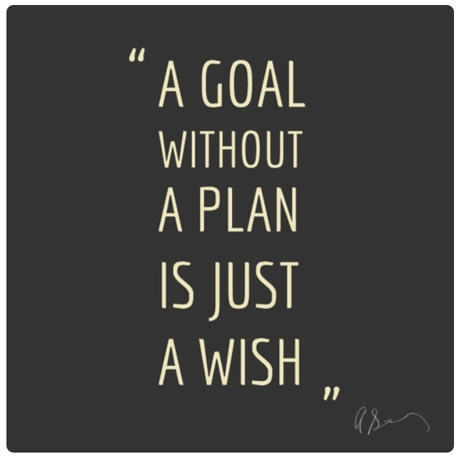

Slide 6
A goal without a plan is just a wish.
Leave a mark.

Slide 7
AGENDA
PART 2: 10 Questions
Complete these questions to get into a pragmatic sales mindset.
Go here.
https://goo.gl/forms/buet6mmUkFg3DpKM2

Slide 8
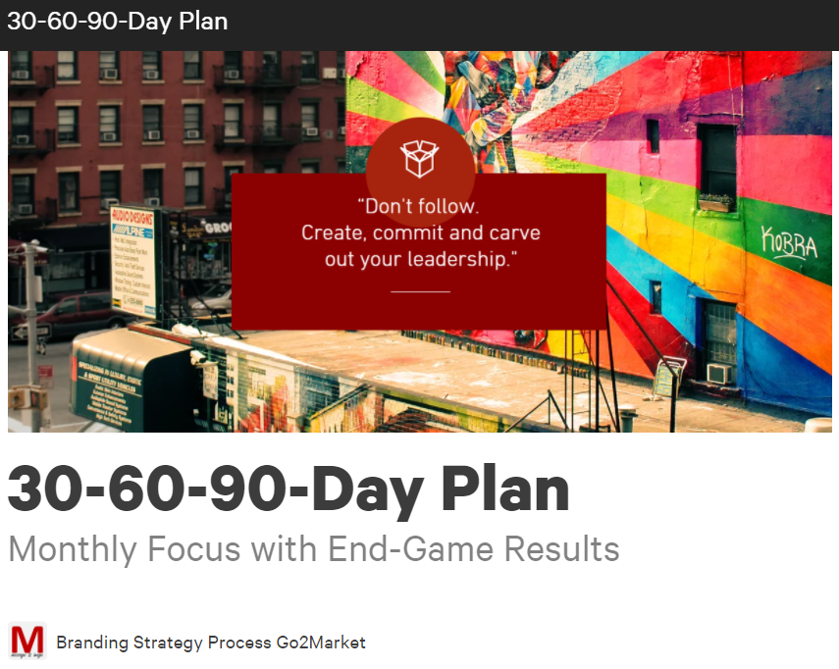

Slide 9
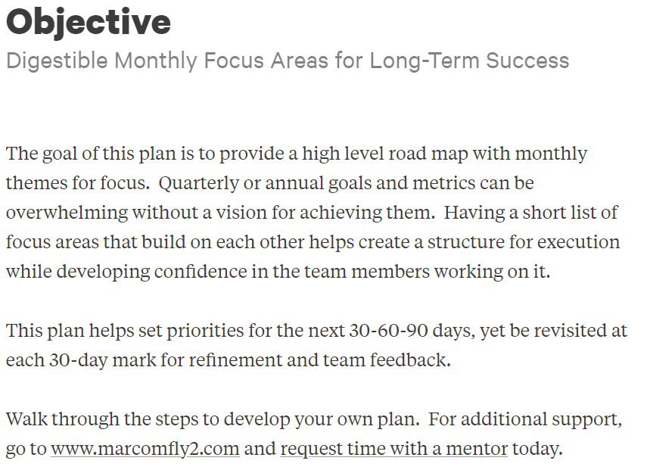
https://marcomfly2.atavist.com/30-60-90-day-plan

Slide 10
Develop Your Plan

Slide 11
Develop Your Plan

Slide 12
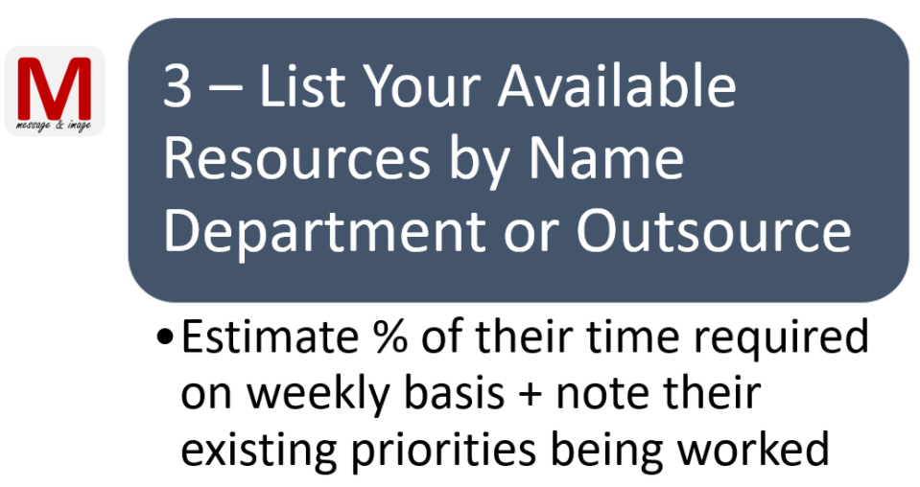
Develop Your Plan

Slide 13
Develop Your Plan

Slide 14
Develop Your Plan

Slide 15
Develop Your Plan

Slide 16
Develop Your Plan

Slide 18
[ENTER THEME]
[ENTER THEME]
[ENTER THEME]
[ENTER THEME]
[Enter key initiative]
[Enter key initiative]
[Enter key initiative]
30
[Enter key initiative]
[Enter key initiative]
[Enter key initiative]
60
[Enter key initiative]
90
180
[Enter key initiative]
[Enter key initiative]
[Enter key initiative]
[Enter key initiative]
[Enter key initiative]

Slide 19
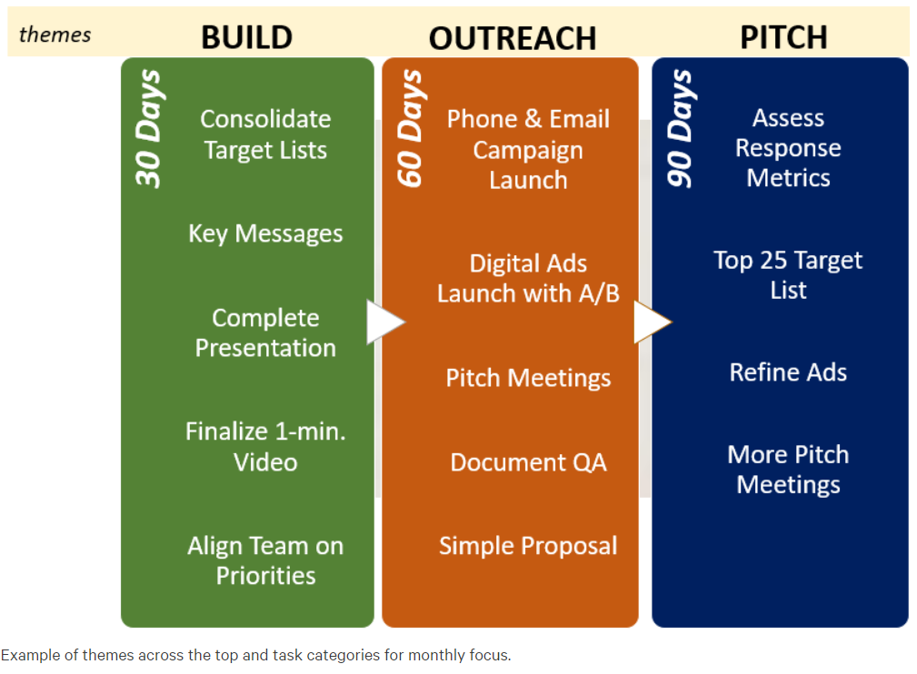

Slide 20
BUILD
REACH
SYSTEMATIC
EXPAND
Success Factor Assessment
BD Resource Increase
Operational Refinement
100 Milestone Check
Quarterly Report
30 Days
Ramp Up Resources
Target Database Build
Sale Tool Development
Partner Tool Development
Speaker Opp Assessment
60 Days
Technical Tools in Place
Rapid BD Outreach
Feedback Tracking Needs
Videos and Webpages
Integrated Marketing
90 Days
180 Days
Partner Co-Marketing
Speaking Opportunities
Hotel Social Communities
Hotel Supplier Forum Meeting
End of Year Goal Sprint

Slide 21
Strategies
Programs
Insert Goals – Try a formula: TA20M2019
(Travel Assistance Goal of $20M by 2019)
Outcomes

Slide 22
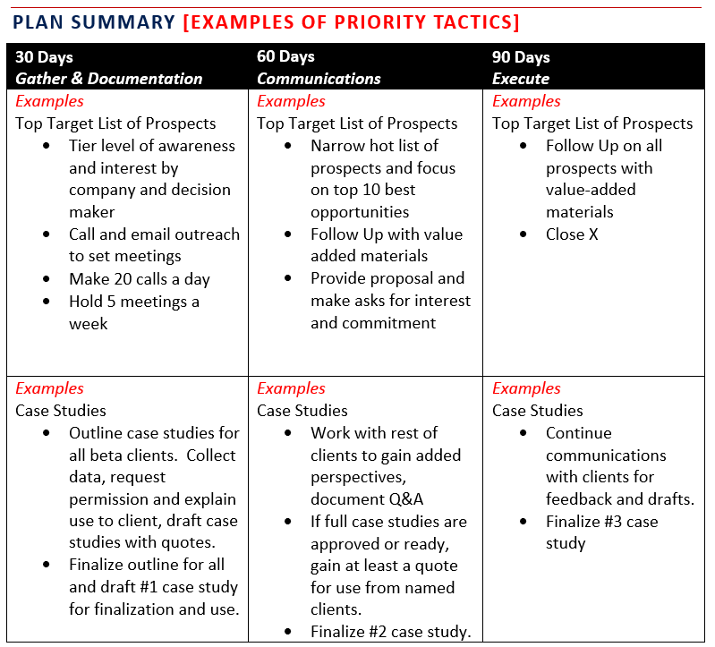

Slide 23
Go to Word Document Template For More…
Priority Sales Goal #1: To close [ENTER SPECIFIC DOLLAR AMOUNT $XXX,XXX] by [ENTER DATE] by closing [ENTER NUMBER OF DEALS].
Supportive-Goal #2: To accomplish [ENTER SPECIFIC KEY PERFORMANCE INDICATOR or KPI] by [ENTER DATE] by doing the following actions: [ENTER ACTIONS REQUIRED].
Supportive-Goal #3: To accomplish [ENTER SPECIFIC KEY PERFORMANCE INDICATOR or KPI] by [ENTER DATE] by doing the following actions: [ENTER ACTIONS REQUIRED].
Go here:
https://drive.google.com/file/d/0BxbN40gvP13ZVjV0NFVMWFNlNzA/view?usp=sharing

Slide 24
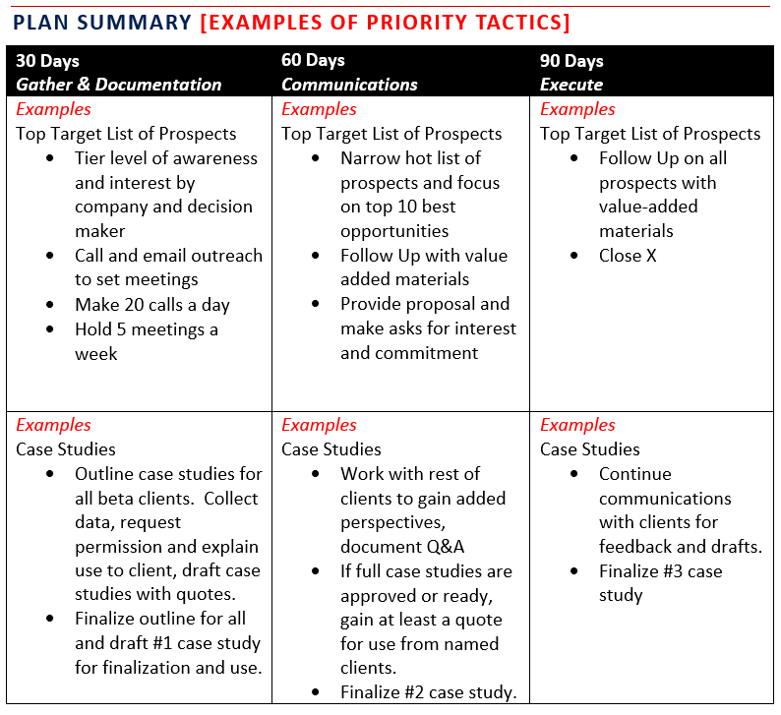
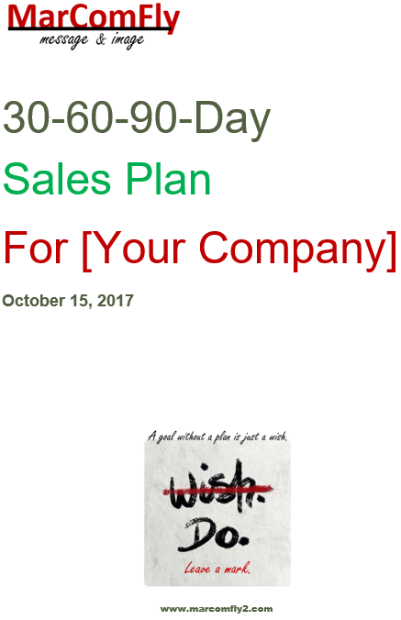
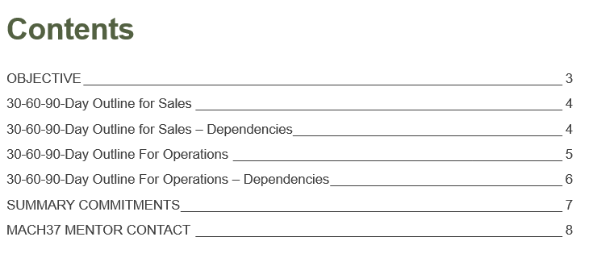
Go to Word Document Template For More…
Go here:
https://drive.google.com/file/d/0BxbN40gvP13ZVjV0NFVMWFNlNzA/view?usp=sharing

Slide 26
GO2MARKET

Slide 27
Content Focus on Blogs,
# form fills # downloads
Digital Presence
# form fills
Webinars
# registrants
Marketing Campaigns
# of inbound leads
Video & Multi Media
# click-throughs
Brand Core
# moments # referrals
SME Storytelling
# followers
CRM Platform
Metrics Tracking
Website Integration
Social Media
# interactions # followers
PR
# of mentions
# share of voice
Speaking Opportunities
# new contacts
Call Campaign
# meetings set
Events
# registrants
# 1-on-1 Meetings

Slide 28
Programs at Each Stage of Sales Funnel
B LIST
Build Awareness
Prompt Consideration & Take Action
Sales Decision
Top
Funnel
Middle Funnel
Bottom Funnel
Post Program Follow Up
A LIST
Moves to Qualified Opportunities Cadence

